Slide 1
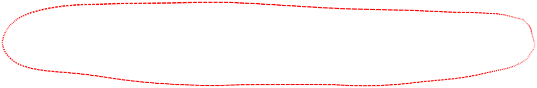
Various camera configurations
Single point of fixation where optical axes intersect
Optical axes parallel (fixation at infinity)
General case

Slide 2
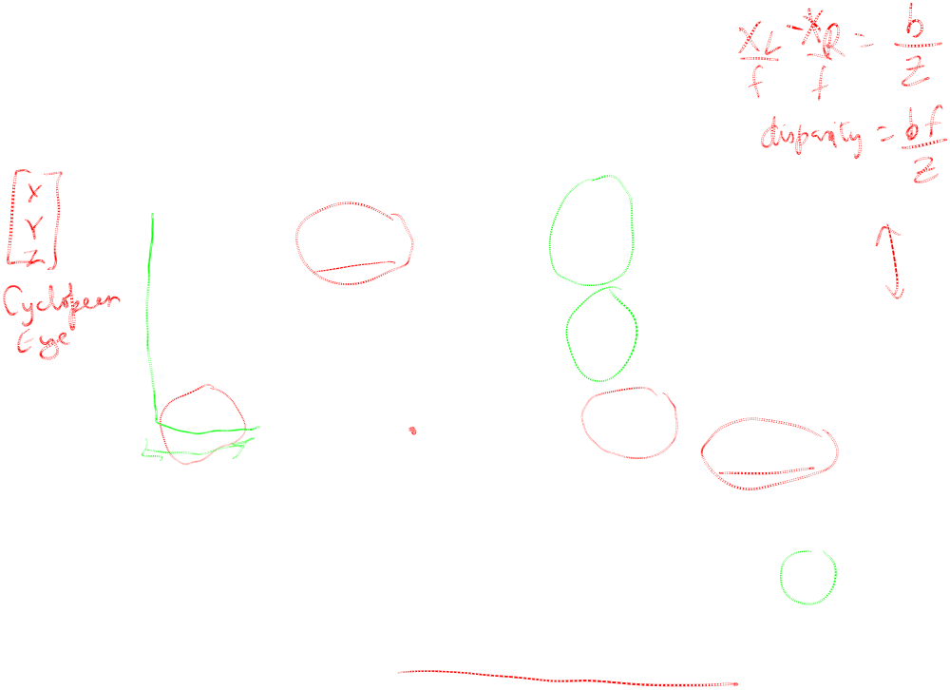


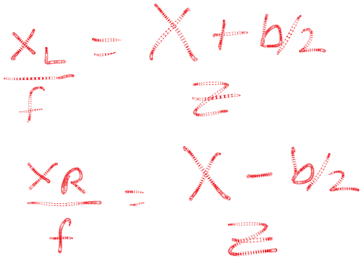

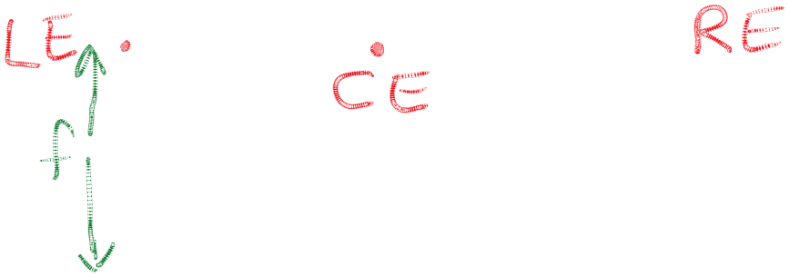



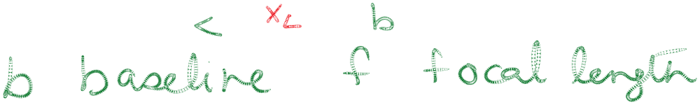


Parallel Optical Axes
(fixation at infinity)

Slide 3
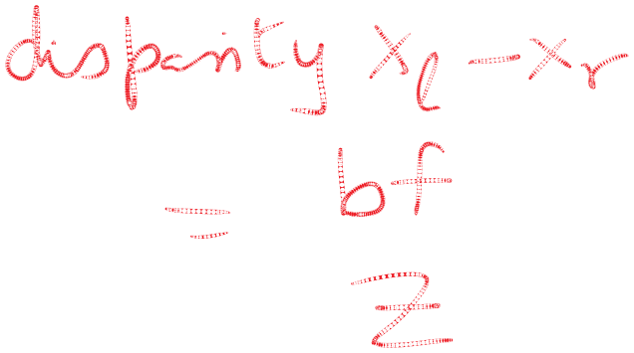


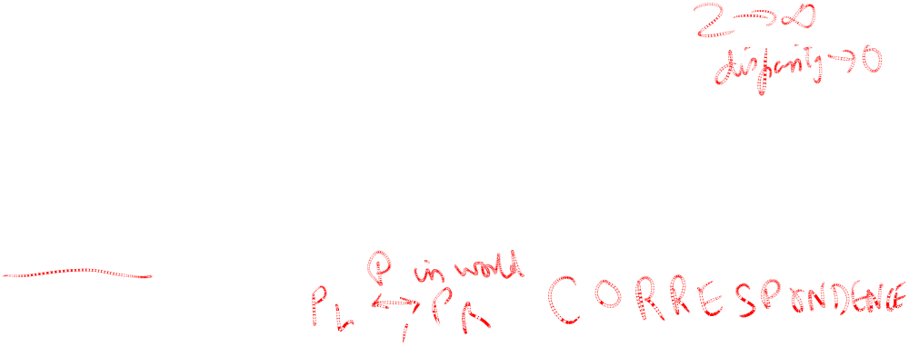


Parallel Optical Axes
(fixation at infinity)

Slide 4
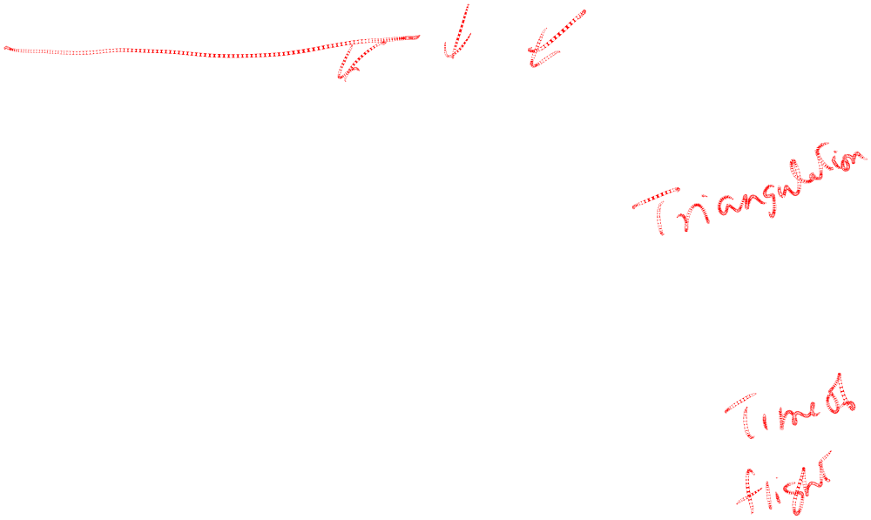
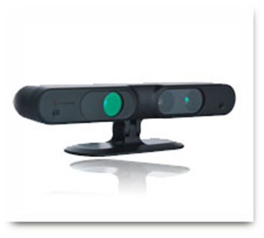
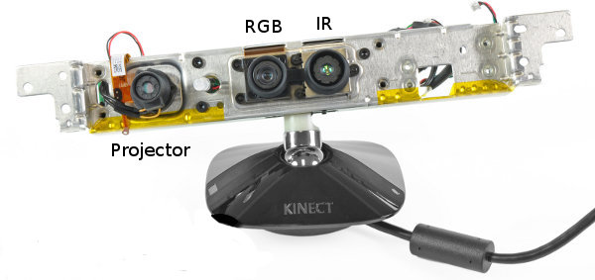
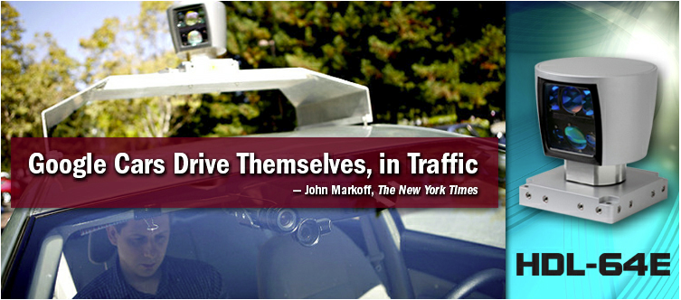
Range Sensors
primesense sensor (used in Kinect)
Velodyne LIDAR Sensor
http://www.primesense.com/, http://www.ifixit.com/,
http://mirror.umd.edu/roswiki/kinect_calibration(2f)technical.html
http://velodynelidar.com/lidar/lidar.aspx

Slide 5

Depth from Triangulation
Camera 1
Camera 2
Camera
Projector
Passive Stereopsis
Active Stereopsis
Active sensing simplifies the problem of estimating point correspondences

Slide 6

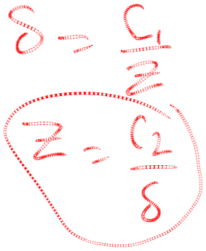
Recall the formula for disparity with parallel optical axes…

Slide 7
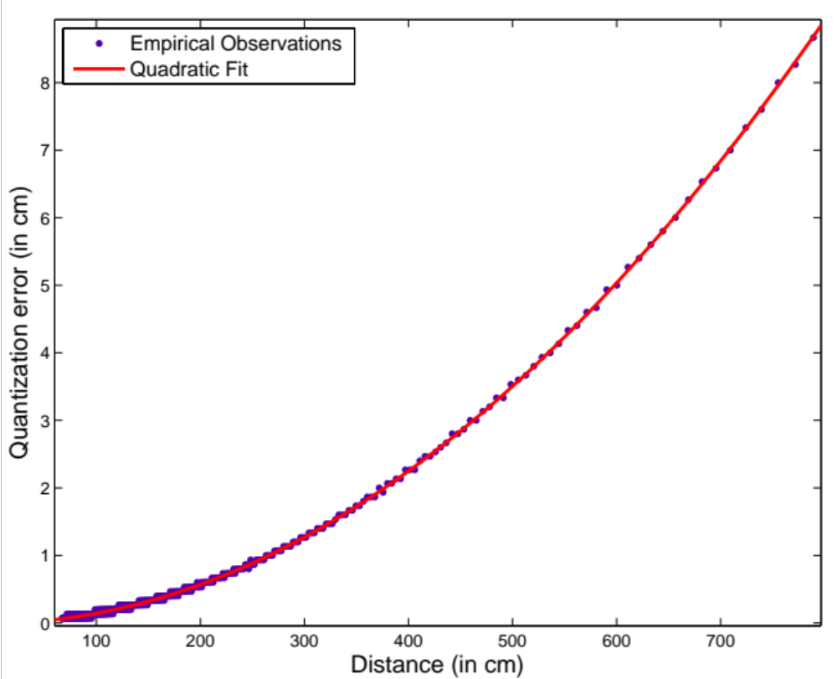
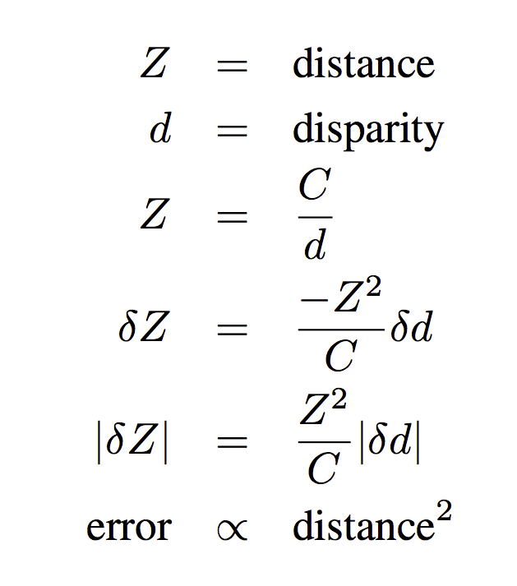
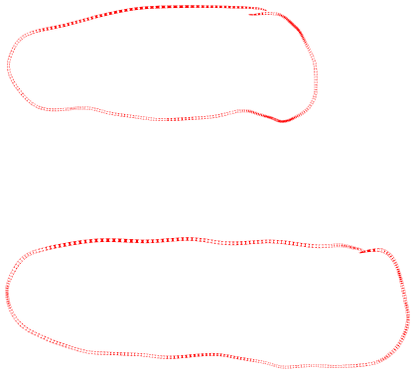
error(distance) – Kinect type sensor
Error in distance estimate increases quadratically with the distance

